Slide 1
Know Your Rights in Demonstrations
Prepared by Eric M. Fink
Elon Law School
Greensboro, North Carolina

Slide 2
Legal Matters
This is a general overview of issues that may arise in political demonstrations and police encounters. The information presented is not offered or intended as legal advice.
This work is licensed under the Creative Commons Attribution-NonCommercial-ShareAlike 4.0 International License. http://creativecommons.org/licenses/by-nc-sa/4.0/

Slide 3
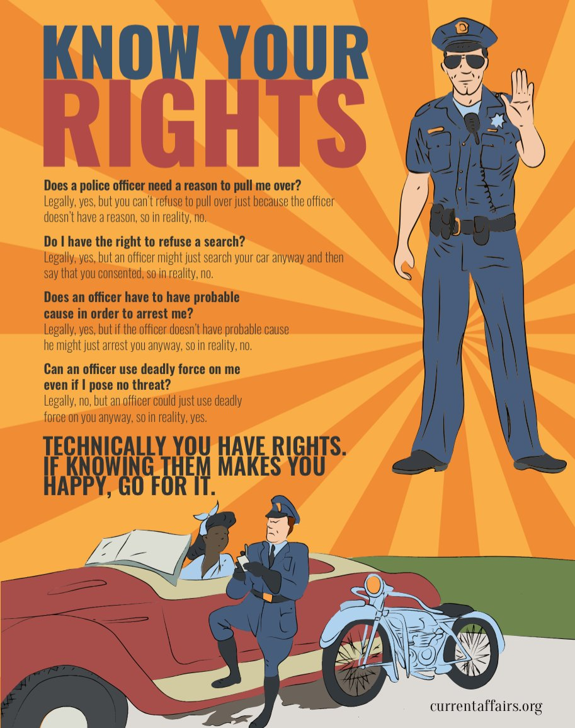

Slide 4
1st Amendment: Speech & Assembly

Slide 5
1st Amendment
Congress shall make no law … abridging the freedom of speech, or of the press; or the right of the people peaceably to assemble, and to petition the Government for a redress of grievances.

Slide 6
1st Amendment
Applies to government restraints on speech & assembly.

Slide 7
1st Amendment
Applies to all levels of government:
Federal
State
Local

Slide 8
1st Amendment
Applies to all government branches & agencies:
Legislative: US Congress, NC General Assembly, County Commission, City Council
Executive: President, Governor, Mayor
Judicial: Courts
Law Enforcement: Police, Prisons

Slide 9
1st Amendment
“Speech” includes non-verbal expressions.

Slide 10
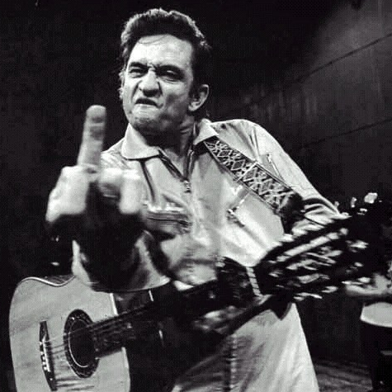
1st Amendment
Body Language

Slide 11
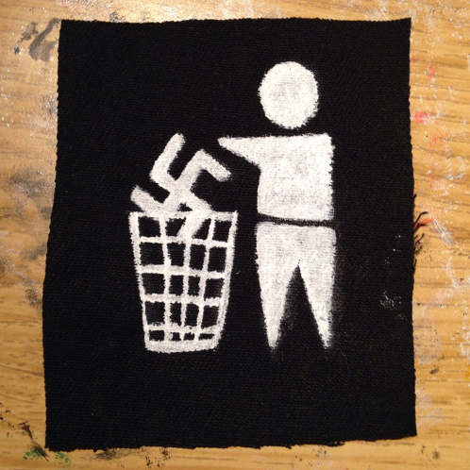
1st Amendment
Clothing

Slide 12
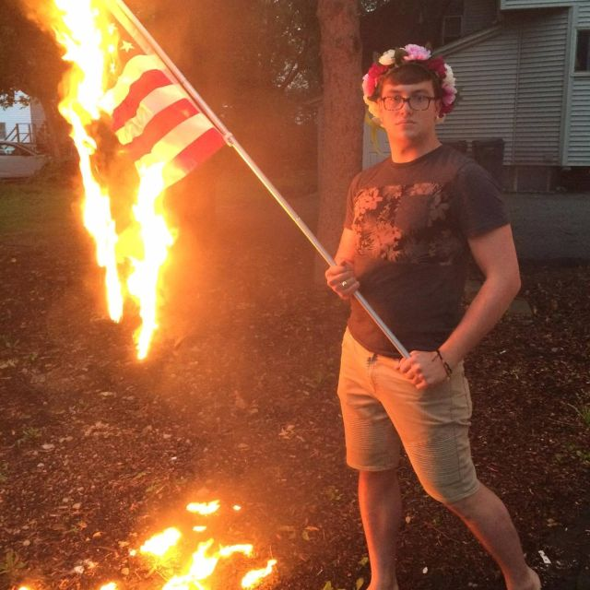
1st Amendment
Conduct

Slide 13
1st Amendment
Government may not prohibit, restrain, limit, or punish protected 1st Amendment activity based on
Content, subject, or viewpoint
Political affiliation, or association

Slide 14
1st Amendment
Applies to prior restraints and to restraints or punishments during or after the protected activity.

Slide 15
1st Amendment
Lawful regulation:
Government may regulate the time, place, & manner of speech/assembly.

Slide 16
1st Amendment
Examples:
Permits for use of certain public places
Noise ordinances & regulations of sound equipment,
Restrictions on posting signs or flyers
Prohibitions against blocking pedestrian or vehicular traffic

Slide 17
1st Amendment
Public Forum: A place traditionally open to unrestricted public speech & activity.
Examples:
Sidewalks
Parks
Plazas outside government buildings

Slide 18
1st Amendment
Protection is greatest, and scope of permissible government regulation narrowest, in traditional public forums. Normally, no permit may be required for these activities in a public forum:
Picketing
Marching
Distributing literature
Soliciting donations

Slide 19
1st Amendment
Even in a traditional public forum, government may regulate or prohibit certain activity that may interfere with access to and use of the space:
May require permits for setting up tables, large signs, etc.
May prohibit blocking entries to buildings
May prohibit blocking others from passing

Slide 20
1st Amendment
Unprotected speech:
Obscenity
But mere profanity is protected
Child Pornography
But pornagraphy that depicts adults is protected if not obscene
Incitement,Fighting Words, True Threats
“imminent lawless action”, “immediate breach of the peace”
Defamation

Slide 21
1st Amendment
Unprotected activity, even if expressive:
Destroying or defacing public or private property (without permission of the property owner)
Use or threat of physical force against others
“True threat” doctrine: context matters

Slide 22
Masks

Slide 23
Masks
Many states have laws that make it a crime to wear a mask or other face covering in a public place (and in some cases on private property).

Slide 24
Masks
N.C.G.S. §14-12.7. Wearing of masks, hoods, etc., on public ways.
No person or persons at least 16 years of age shall, while wearing any mask, hood or device whereby the person, face or voice is disguised so as to conceal the identity of the wearer, enter, be or appear upon any lane, walkway, alley, street, road, highway or other public way in this State.
N.C.G.S. §14-12.8. Wearing of masks, hoods, etc., on public property.
No person or persons shall in this State, while wearing any mask, hood or device whereby the person, face or voice is disguised so as to conceal the identity of the wearer, enter, or appear upon or within the public property of any municipality or county of the State, or of the State of North Carolina.
N.C.G.S. § 14-12.10. Holding meetings or demonstrations while wearing masks, hoods, etc.
No person or persons at least 16 years of age shall while wearing a mask, hood or device whereby the person, face or voice is disguised so as to conceal the identity of the wearer, hold any manner of meeting, or make any demonstration upon the private property of another unless such person or persons shall first obtain from the owner or occupier of the property his or her written permission to do so, which said written permission shall be recorded in the office of the register of deeds of the county in which said property is located before the beginning of such meeting or demonstration.

Slide 25
Masks
Some of these laws also prohibit wearing a mask or face covering on private property without the owner’s permission.

Slide 26
Masks
N.C.G.S. § 14-12.9. Entry, etc., upon premises of another while wearing mask, hood or other disguise.
No person or persons at least 16 years of age shall, while wearing a mask, hood or device whereby the person, face or voice is disguised so as to conceal the identity of the wearer, demand entrance or admission, enter or come upon or into, or be upon or in the premises, enclosure or house of any other person in any municipality or county of this State.

Slide 27
Masks
Such laws usually include exemptions for certain specified purposes or activities.

Slide 28
Masks
N.C.G.S. § 14-12.11. Exemptions from provisions of Article.
The following are exempted from the provisions of G.S. 14-12.7, 14-12.8, 14-12.9, 14-12.10 and 14-12.14:
(1)Any person or persons wearing traditional holiday costumes in season;
(2)Any person or persons engaged in trades and employment where a mask is worn for the purpose of ensuring the physical safety of the wearer, or because of the nature of the occupation, trade or profession;
(3)Any person or persons using masks in theatrical productions including use in Mardi Gras celebrations and masquerade balls;
(4)Persons wearing gas masks prescribed in civil defense drills and exercises or emergencies; and
(5)Any person or persons, as members or members elect of a society, order or organization, engaged in any parade, ritual, initiation, ceremony, celebration or requirement of such society, order or organization, and wearing or using any manner of costume, paraphernalia, disguise, facial makeup, hood, implement or device, whether the identity of such person or persons is concealed or not, on any public or private street, road, way or property, or in any public or private building, provided permission shall have been first obtained therefor by a representative of such society, order or organization from the governing body of the municipality in which the same takes place, or, if not in a municipality, from the board of county commissioners of the county in which the same takes place.
Provided, that the provisions of this Article shall not apply to any preliminary meetings held in good faith for the purpose of organizing, promoting or forming a labor union or a local organization or subdivision of any labor union nor shall the provisions of this Article apply to any meetings held by a labor union or organization already organized, operating and functioning and holding meetings for the purpose of transacting and carrying out functions, pursuits and affairs expressly pertaining to such labor union.

Slide 29
Masks
Some of these laws only apply if the mask is worn with some malicious intent toward others, or with the intent of avoiding identification while committing some other crime.

Slide 30
Masks
D.C. Code § 22-3312.03. Wearing hoods or masks. (a) No person or persons over 16 years of age, while wearing any mask, hood, or device whereby any portion of the face is hidden, concealed, or covered as to conceal the identity of the wearer, shall: (1) Enter upon, be, or appear upon any lane, walk, alley, street, road highway, or other public way in the District of Columbia; (2) Enter upon, be, or appear upon or within the public property of the District of Columbia; or (3) Hold any manner of meeting or demonstration. (b) The provisions of subsection (a) of this section apply only if the person was wearing the hood, mask, or other device: (1) With the intent to deprive any person or class of persons of equal protection of the law or of equal privileges and immunities under the law, or for the purpose of preventing or hindering the constituted authorities of the United States or the District of Columbia from giving or securing for all persons within the District of Columbia equal protection of the law; (2) With the intent, by force or threat of force, to injure, intimidate, or interfere with any person because of his or her exercise of any right secured by federal or District of Columbia laws, or to intimidate any person or any class of persons from exercising any right secured by federal or District of Columbia laws; (3) With the intent to intimidate, threaten, abuse, or harass any other person; (4) With the intent to cause another person to fear for his or her personal safety, or, where it is probable that reasonable persons will be put in fear for their personal safety by the defendant's actions, with reckless disregard for that probability; or (5) While engaged in conduct prohibited by civil or criminal law, with the intent of avoiding identification.

Slide 31
Masks
The constitutional status of anti-mask laws is uncertain.
Courts have upheld criminal convictions under these laws against challenges based on the 1st Amendment. See, e.g., Church of Am. Knights of the Ku Klux Klan v. Kerik, 356 F.3d 197 (2d Cir. 2004)
But selective enforcement or prosecution based on viewpoint, political association, etc. would violate the 1st Amendment

Slide 32
Photographs & Recordings

Slide 33
Photography & Video Recording
A person who is lawfully present in a public place may take photographs or video recordings of anything and any person in plain view.

Slide 34
Photography & Video Recording
A police officer or other government actor may not lawfully prohibit you from, or arrest you for, taking photos or video recordings in a public place.

Slide 35
Photography & Video Recording
A police officer or other government actor may not lawfully seize your equipment, demand to view your photos or video, or delete your photos or video without a warrant.

Slide 36
Photography & Video Recording
A police officer or other government actor may lawfully order you to cease activity, including photography or video recording, if it is interfering with an arrest or other legitimate law enforcement activity.

Slide 37
Photography & Video Recording
You do not need permission to photograph or make video recordings of any person who is in plain view from a public place.
Many people do not understand this and may object that taking photos or making video recordings of them without their permission is a violation of their privacy or other legal rights.
It is unlawful for any person to use physical force to stop you from taking photos or video recordings in a public place .

Slide 38
Photography & Video Recording
The owner of private property may prohibit or restrict photography and video recording on the property.
But a property owner may not prohibit you from taking photos or video recordings of the property from a public place.

Slide 39
Photography & Video Recording
Several states, including North Carolina, have enacted so-called “Ag-Gag” or “Data Trespass” laws that restrict photographs, videos, and other recording of private property without the owner’s permission.
As applied to photography or recording made from a public place, criminal or civil liability under those laws is likely unconstitutional.

Slide 40
Audio Recording
Audio recordings may be subject to greater restriction.
In some states (including NC, VA, & DC), it is lawful to make an audio recording of a conversation as long as one party to the conversation consents.
This may include the person who is making the recording, if that person is also a party to the conversation.
In other states, all parties to the conversation must consent.

Slide 41
Police Encounters

Slide 42
Police Questioning
In general, a police officer may lawfully ask you questions at any time, without having to demonstrate reasonable suspicion or probable cause.

Slide 43
Police Questioning
The constitutional “right to remain silent” means that you are not required to answer questions from a police officer or other government agent.

Slide 44
Police Questioning
The right to refuse to answer questions applies whether or not you have been arrested or taken into custody.
It applies whether or not you have been given the standard Miranda warning.
You are not required to tell the officer that you are exercising your right to remain silent.
Even if you answer some questions, you may still stop and refuse to answer any further questions until you have a lawyer.
You may not lawfully be arrested or punished for failing or refusing to answer.

Slide 45
Police Questioning
Exceptions:
In some states (not NC), if you are stopped by a law enforcement officer you may be required to give your name.
But you are not required to answer any other questions (e.g. address, etc.)
If you are driving a motor vehicle and are stopped for a traffic violation, you may be required to show your driver’s license, registration, and proof of insurance
Again, you are not required to answer any questions

Slide 46
Police Questioning
If you do speak to a law enforcement officer, your statements may be used against you and others.

Slide 47
Police Questioning
It is a criminal offense to provide false information to a police officer or other government official is a criminal offense.

Slide 48
Police Questioning
You have a right to consult with a lawyer before agreeing to speak to a police officer or other government official.

Slide 49
Police Questioning
Police officers may try to pressure or persuade you to speak to them without a consulting a lawyer. Bear in mind that the police are legally permitted to lie to you.

Slide 50
Police Questioning
They may say that you are better off without a lawyer.
This is almost never true.
They may threaten you with a grand jury subpoena
They may be bluffing and even if they’re not, you are entitled to consult with a lawyer before testifying
They may promise leniency in criminal charges or sentencing.
Criminal charges and plea bargains are up to the prosecutor, not the police.

Slide 51
Police Stops & Detention
If you are stopped by a police officer, you are legally entitled to walk away unless you have been detained or arrested.

Slide 52
Police Stops & Detention
If you’re unsure, you can ask if you are free to go.
It’s generally a good idea to walk away calmly.
If you run, or otherwise act in a “furtive” “suspicious” manner, the officer might use that as a pretext to detain or arrest you.
It’s generally not a good idea to insult or argue with the officer.
Even though your statements may be protected under the 1st Amendment, it’s likely to provoke a bad response from the officer.

Slide 53
Police Stops & Detention
Detention means that you have been stopped by a police officer and are not free to go.

Slide 54
Police Stops & Detention
Detention may lead to an arrest, but it is not the same thing.

Slide 55
Police Stops & Detention
If you are detained but not arrested, your constitutional rights (including the right to remain silent) still apply, but the police are not required to inform you of those rights.

Slide 56
Police Stops & Detention
If you are detained, the officer may conduct a “pat down” (an external check) for weapons.

Slide 57
Police Stops & Detention
Legally, a police officer is required to have “reasonable suspicion” that you are armed and dangerous before conducting a pat down.
The officer is likely to cite your “furtive” or “suspicious” movements or demeanor (e.g. “he reached for his waistband”) to justify a pat down.

Slide 58
Searches
If you are detained but not arrested, the officer may not lawfully conduct any search beyond a pat-down (e.g. inside your pockets, under your clothing, inside a bag or other item) without your consent or “probably cause” (a stricter requirement than “reasonable suspicion”).

Slide 59
Searches
You can (and should) tell the officer you do not consent to the search.
Refusal to consent is not probable cause for a search.
If the officer proceeds (as they most likely will), you do not have a legal right to physically resist.

Slide 60
Searches
Probable cause means that the officer has knowledge of facts sufficient to support a reasonable belief that,
Criminal activity is likely taking place,
You have been involved in a crime, or
You have evidence of a crime in your possession (or in your vehicle)

Slide 61
Arrest
Probable cause is also required for an arrest.

Slide 62
Arrest
If you are placed under arrest, the officer must then advise you of your constitutional rights (“Miranda warning”).
Those rights apply even if the officer fails to provide the warning.

Slide 63
Arrest
Once you have been placed under arrest, the police may lawfully conduct a search.
They may search inside your clothing and any objects you are holding or carrying.
They may also search the area within your immediate control.

Slide 64
Arrest
You have the right to make a phone call within a reasonable time after being arrested.
The police may not listen to your calls with your lawyer.
But they may (and mostly likely will) listen to any other calls.

Slide 65
Arrest
You have the right to appear before a judge or magistrate within a reasonable time after being arrested (usually within 48 hours).

Slide 66
Arrests
The purpose of this appearance will be to hear the formal charges against you, to decide on bail, and to enter a plea.

Slide 67
Arrests
You have a right to be represented by a lawyer at this and all other court appearances.
If you can’t afford a lawyer, you have a right to be represented by a public defender or other court-appointed lawyer.

